Slide 1
Python Inner Functions
DVT101 – Lecture 21
- By Dataverse Tutorials

Slide 2
What are Inner Functions in Python?
Function inside another function
Also called Nested Functions
Used for better structure and safety
Common in decorators and closures

Slide 3
Why Inner Functions Are Needed
Encapsulation (logic hiding)
Avoid global pollution
Improve readability
Used in advanced Python

Slide 4
Basic Structure of Inner Function
Outer function defined first
Inner function defined inside it
Inner function can access outer variables
Inner function is not directly accessible

Slide 5
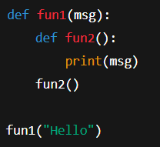
Simple Inner Function Example
Inner function defined inside outer function
Inner function accesses outer variable
Demonstrates lexical scoping
Basic concept of nested functions

Slide 6
Variable Scope in Inner Functions (LEGB Rule)
Local
Enclosing
Global
Built-in

Slide 7
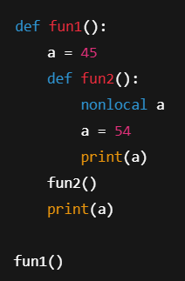
Modifying Outer Variable using nonlocal
nonlocal keyword usage
Modify enclosing scope variable
Avoid creating new local variable
Useful in state management

Slide 8
Closure Concept
Function remembers value
Even after outer function ends
Used in decorators
Powerful feature

Slide 9
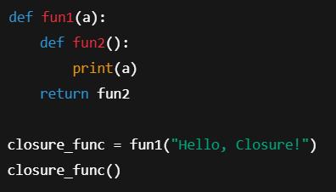
Closure Example
Function returns another function
Inner function remembers value
Closure concept demonstration
Used in decorators

Slide 10
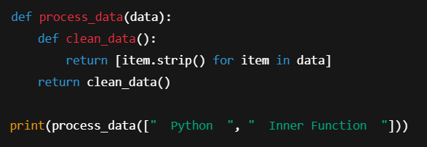
Real World Use: Data Cleaning
Encapsulation of helper logic
Inner function for preprocessing
Cleaner and safer code
Real-world data handling

Slide 11
Inner Functions in Logging & Decorators
Wrapper functions
Logging
Authentication
Authorization

Slide 12
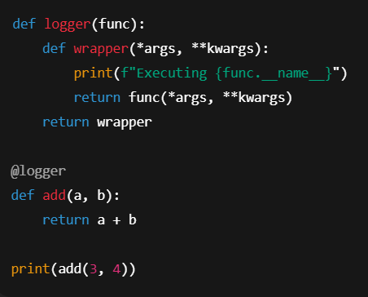
Logging Example (Decorator Style)
Inner function as wrapper
Logging before execution
Foundation of decorators
Industry-grade use case

Slide 13
Summary & Key Takeaways
Inner functions improve structure
Support closures and decorators
Enable safe encapsulation
Widely used in industry

Slide 14


